Slide 1
Evaluation Methods: Part 2 Difference in Differences
American Society of Criminology
November 14, 2023

Slide 2
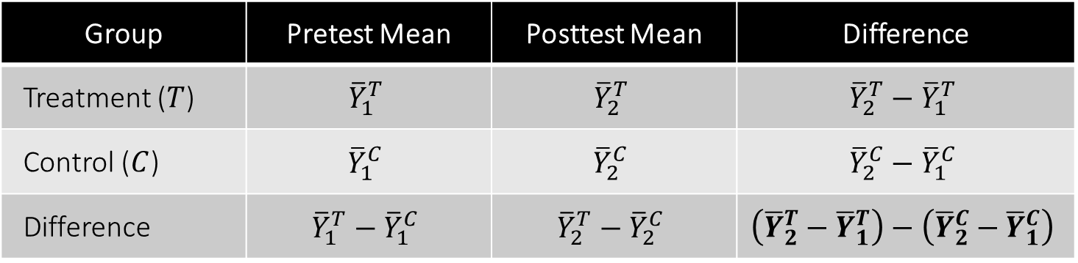
Difference in Differences Design
Group | Pretest Mean | Posttest Mean | Difference
Treatment ($T$) | $${\overline{Y}}_{1}^{T}$$ | $${\overline{Y}}_{2}^{T}$$ | $${\overline{Y}}_{2}^{T}−{\overline{Y}}_{1}^{T}$$
Control ($C$) | $${\overline{Y}}_{1}^{C}$$ | $${\overline{Y}}_{2}^{C}$$ | $${\overline{Y}}_{2}^{C}−{\overline{Y}}_{1}^{C}$$
Difference | $${\overline{Y}}_{1}^{T}−{\overline{Y}}_{1}^{C}$$ | $${\overline{Y}}_{2}^{T}−{\overline{Y}}_{2}^{C}$$ | $$\left({\overline{Y}}_{2}^{T}−{\overline{Y}}_{1}^{T}\right)−\left({\overline{Y}}_{2}^{C}−{\overline{Y}}_{1}^{C}\right)$$
Classic experimental design is the inspiration for the “difference in differences,” which measures growth in the treatment group, less growth in the control group
Control group defines the outcome trajectory in the absence of the intervention
Assumption is that treatment group would have followed a parallel trajectory, so any “excess” growth at posttest is attributable to the intervention

Slide 3
Difference in Differences Design
Logic of twice differencing
Before/after differencing ⇒ Eliminates time-invariant unobservables (“unobserved heterogeneity”), which is a major source of omitted variables bias in panel data
Group-wise differencing ⇒ Adjusts for baseline growth or change absent the intervention (e.g., historical event, development/maturation, instrumentation change)
If groups are following “parallel pretrends,” the DID yields an estimate of the average treatment effect on the treated (ATT)
Control group defines trajectory the treatment group would have followed in the absence of the intervention, so treatment group trajectory represents the “gain” from treatment

Slide 4
Quasi-Experimental Design
Impact of Criminal Conviction on Employment

Slide 5
Conviction Data
conviction-work.csv
Variable | Description
id | Unique respondent ID.
male | = 1 if male.
minrty | = 1 if non-white.
cohort | Age as of year-end 1996.
age_1 – age_15 | Age at interview (rounds 1-15).
work_1 – work_15 | = 1 if employed since the last interview (rounds 1-15).
arrest_1 – arrest_15 | = 1 if arrested since the last interview (rounds 1-15).
convic_1 – convic_15 | = 1 if convicted since the last interview (rounds 1-15).
age1arrest | Age (at interview) of first reported arrest.
age1convic | Age (at interview) of first reported conviction.
wave1arrest | Interview round of first arrest.
wave1convic | Interview round of first conviction.

Slide 6
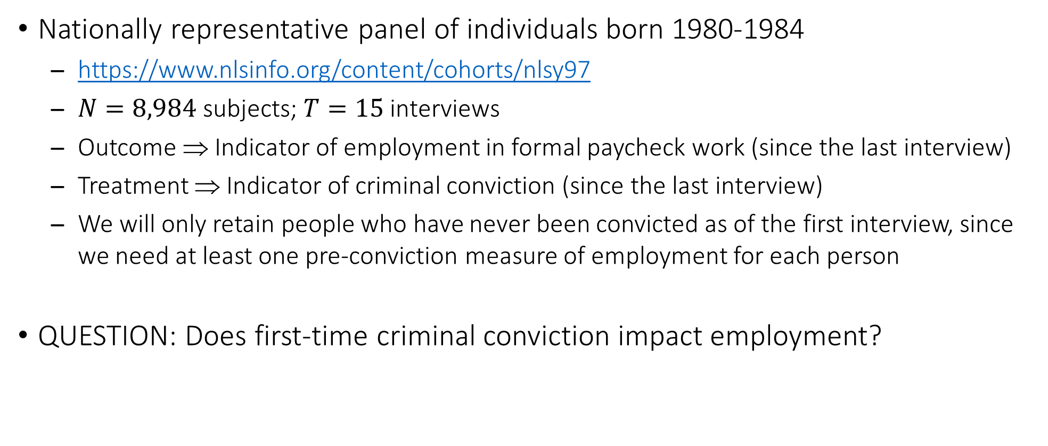
National Longitudinal Survey of Youth
Nationally representative panel of individuals born 1980-1984
https://www.nlsinfo.org/content/cohorts/nlsy97
$N=8,984$ subjects; $T=15$ interviews
Outcome ⇒ Indicator of employment in formal paycheck work (since the last interview)
Treatment ⇒ Indicator of criminal conviction (since the last interview)
We will only retain people who have never been convicted as of the first interview, since we need at least one pre-conviction measure of employment for each person
QUESTION: Does first-time criminal conviction impact employment?

Slide 7
Conviction Data: Load Packages
library(broom)
library(did)
library(fixest)
library(ggiplot)
library(lmtest)
library(sandwich)
library(tidyverse)
As before, these should already be installed before we may load them for use in our program.

Slide 8
Conviction Data: Read in Data
nlsy <- read_csv("conviction-work.csv")
names(nlsy)
## [1] "id" "male" "minrty" "cohort" "age_1" "age_2"
## [7] "age_3" "age_4" "age_5" "age_6" "age_7" "age_8"
## [13] "age_9" "age_10" "age_11" "age_12" "age_13" "age_14"
## [19] "age_15" "work_1" "work_2" "work_3" "work_4" "work_5"
## [25] "work_6" "work_7" "work_8" "work_9" "work_10" "work_11"
## [31] "work_12" "work_13" "work_14" "work_15" "arrest_1" "arrest_2"
## [37] "arrest_3" "arrest_4" "arrest_5" "arrest_6" "arrest_7" "arrest_8"
## [43] "arrest_9" "arrest_10" "arrest_11" "arrest_12" "arrest_13" "arrest_14"
## [49] "arrest_15" "convic_1" "convic_2" "convic_3" "convic_4" "convic_5"
## [55] "convic_6" "convic_7" "convic_8" "convic_9" "convic_10" "convic_11"
## [61] "convic_12" "convic_13" "convic_14" "convic_15" "age1arrest" "age1convic"
## [67] "wave1arrest" "wave1convic"

Slide 9
Conviction Data: Exclusions and Treatment Variable
nlsy <- nlsy %>% filter(is.na(wave1convic) | wave1convic > 1)
dim(nlsy)
## [1] 8777 68
nlsy <- nlsy %>% mutate(treated = replace_na(if_else(wave1convic >= 1, 1, 0), 0))
table(nlsy$treated)
## 0 1
## 7199 1578
mean(nlsy$treated)
## [1] 0.1797881
This drops respondents who have been convicted as of the first interview. We will retain those who are either never convicted or to-be-convicted.
The new variable treated is a dummy variable for whether a respondent is treated or untreated. The arguments for if_else() are an assertion, the value assigned if the assertion is true, and the value assigned if the assertion is false. With if_else() embedded in replace_na(), we temporarily treat missing values of wave1convic (implying never convicted) as 0s—the default behavior of the program is to ignore missing values.

Slide 10
Conviction Data: Pivot from Wide to Long
nlsy.long <- nlsy %>% pivot_longer(cols = age_1:convic_15, names_to = c(".value", "t"), names_sep = "_")
dim(nlsy.long)
## [1] 131655 14
names(nlsy.long)
## [1] "id" "male" "minrty" "cohort" "age1arrest" "age1convic"
## [7] "wave1arrest" "wave1convic" "treated" "t" "age" "work"
## [13] "arrest" "convic"
The data frame is currently wide and we need to make it long. The pivot_longer() options we must specify are cols (variable names to reshape), names_to (how to split variable names to generate the pivoted variables and the new column variable), and names_sep (expression that splits the variable stub and suffix).

Slide 11
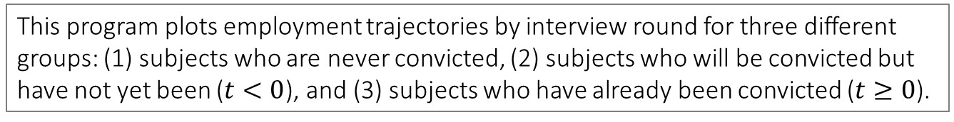
Conviction Data: Employment by Interview Round
nlsy.long <- nlsy.long %>% mutate(t = as.numeric(t),
time1treated = replace_na(t - wave1convic, 0),
group = case_when(treated == 0 ~ 0,
treated == 1 & time1treated < 0 ~ 1,
treated == 1 & time1treated >= 0 ~ 2))
ggplot(nlsy.long, aes(x = t, y = work, color = as.factor(group))) + geom_smooth(se = FALSE) + scale_color_discrete(name = "Treatment Group", labels = c("Never Convicted", "Ever Convicted, Pretest", "Ever Convicted, Posttest")) + theme_gray(base_size = 15) + theme(legend.position = c(0.85, 0.15)) + labs(x = "Interview Round", y = "Proportion Employed", title = "Distribution of Employment, by Time and Conviction Status")
This program plots employment trajectories by interview round for three different groups: (1) subjects who are never convicted, (2) subjects who will be convicted but have not yet been ($t<0$), and (3) subjects who have already been convicted ($t≥0$).

Slide 12
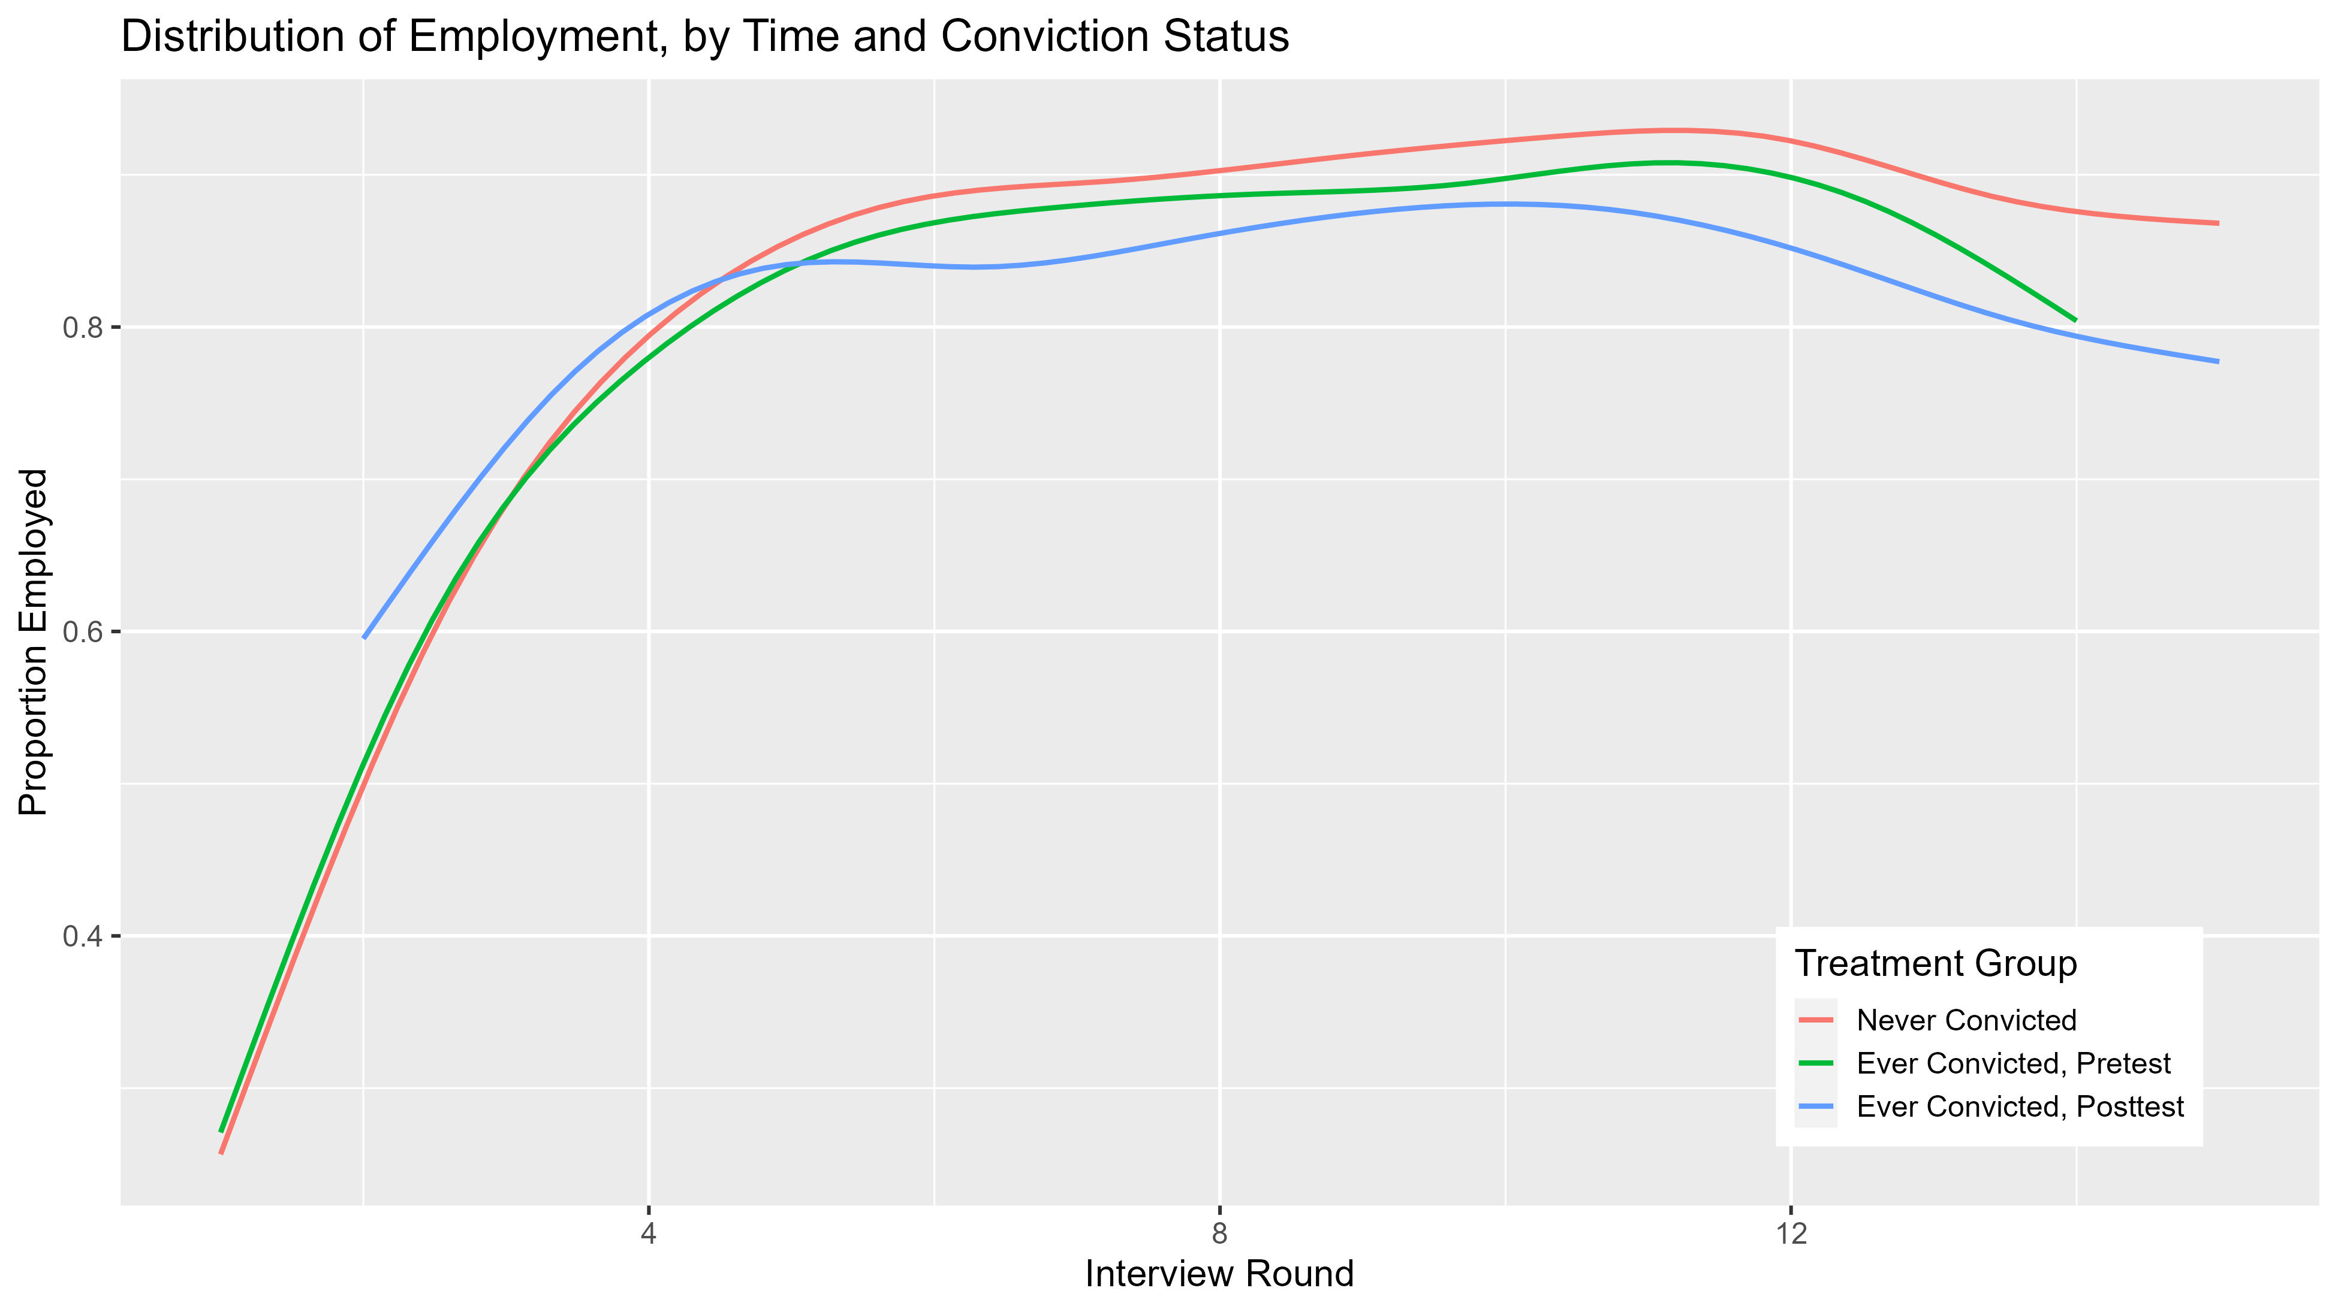
The pretest trends in employment look very similar, which we can see by comparing never-convicted individuals with ever-convicted individuals at pretest (i.e., prior to their first conviction). If anything, ever-convicted are actually a bit precocious in their work involvement at early rounds.
The fact employment tends to be lower post-conviction—relative to both never-convicted individuals and ever-convicted individuals at pretest, at least after about the 4th round—provides visual indication of a possible treatment effect of conviction.

Slide 13
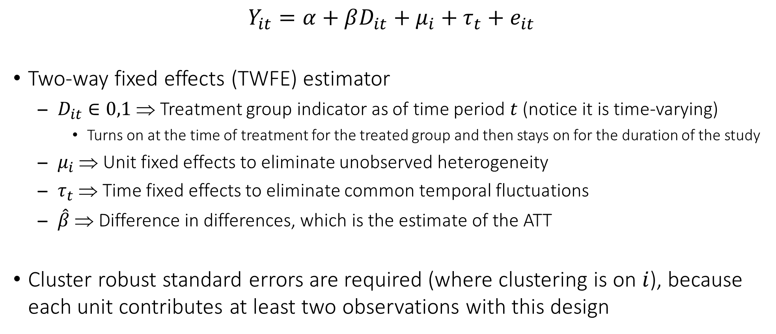
Regression Estimation of Difference in Differences
$$Y_{it}=α+βD_{it}+μ_{i}+τ_{t}+e_{it}$$
Two-way fixed effects (TWFE) estimator
$D_{it}∈0,1$ ⇒ Treatment group indicator as of time period $t$ (notice it is time-varying)
Turns on at the time of treatment for the treated group and then stays on for the duration of the study
$μ_{i}$ ⇒ Unit fixed effects to eliminate unobserved heterogeneity
$τ_{t}$ ⇒ Time fixed effects to eliminate common temporal fluctuations
$\hat{β}$ ⇒ Difference in differences, which is the estimate of the ATT
Cluster robust standard errors are required (where clustering is on $i$), because each unit contributes at least two observations with this design

Slide 14
Using R for Estimation of the Difference in Differences
feols(yvar ~ tvar | idvar + time, panel.id = ~ idvar + time, data = df)
Covariates may be added by specifying yvar ~ tvar + xvar
panel.id declares panel data in case we wish to use lags and leads
Default clustering for the standard errors is by the first variable specified after the pipe, or equivalently, as option cluster = ~ idvar
The feols() command is from the fixest package
https://cran.r-project.org/web/packages/fixest/vignettes/fixest_walkthrough.html

Slide 15
Conviction Data: Two-Way Fixed Effects
nlsy.long <- nlsy.long %>% mutate(tv.treated = treated == 1 & time1treated >= 0)
twfe <- feols(work ~ tv.treated | id + t, cluster = ~ id, data = nlsy.long)
tidy(twfe)
## # A tibble: 1 × 5
## term estimate std.error statistic p.value
## <chr> <dbl> <dbl> <dbl> <dbl>
## 1 tv.treatedTRUE -0.0685 0.00873 -7.85 4.70e-15
We first need a time-varying measure of treatment. This is what we include in the TWFE model. feols() does not produce extraneous output, like all the dummy coefficients for id and t. It also automatically clusters the standard errors by id, so we avoid having to use vcovCL() in a second step. So the cluster = ~ id option is technically redundant.

Slide 16
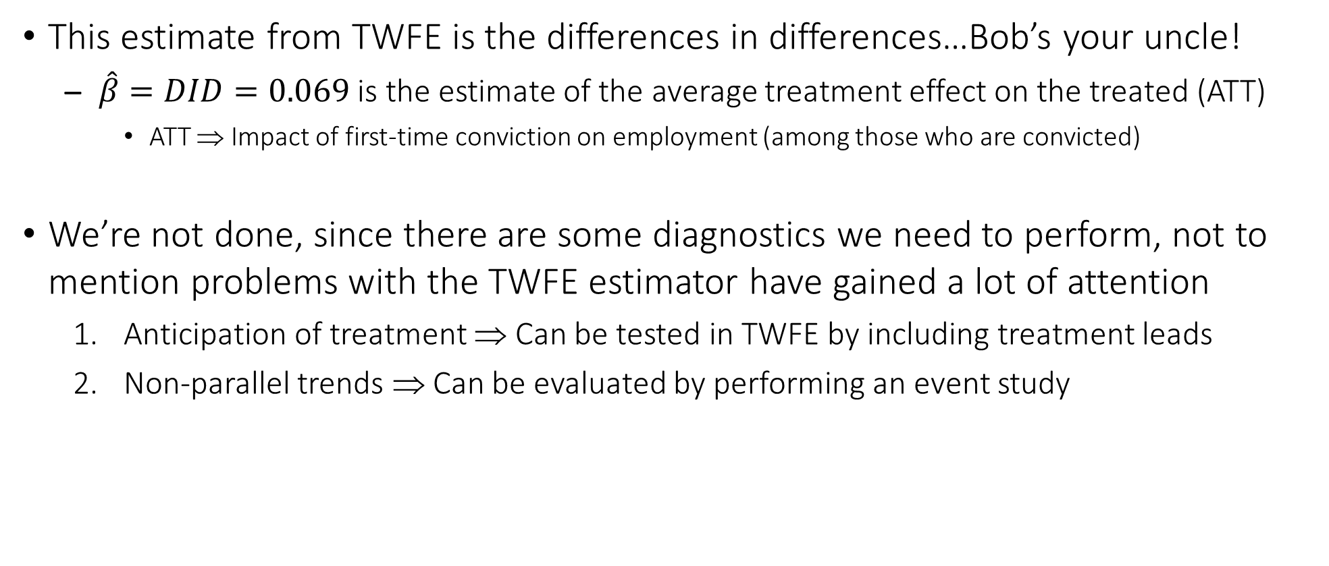
Conviction Data: Follow-Up Diagnostics after TWFE
This estimate from TWFE is the differences in differences…Bob’s your uncle!
$\hat{β}=DID=0.069$ is the estimate of the average treatment effect on the treated (ATT)
ATT ⇒ Impact of first-time conviction on employment (among those who are convicted)
We’re not done, since there are some diagnostics we need to perform, not to mention problems with the TWFE estimator have gained a lot of attention
Anticipation of treatment ⇒ Can be tested in TWFE by including treatment leads
Non-parallel trends ⇒ Can be evaluated by performing an event study

Slide 17
Conviction Data: Test of Anticipation via Treatment Leads
twfe.leads <- feols(work ~ f(tv.treated, 2:0) | id + t, panel.id = ~ id + t, cluster = ~ id, data = nlsy.long)
tidy(twfe.leads)
## # A tibble: 3 × 5
## term estimate std.error statistic p.value
## <chr> <dbl> <dbl> <dbl> <dbl>
## 1 f(tv.treated, 2)TRUE 0.00727 0.0116 0.628 5.30e- 1
## 2 f(tv.treated, 1)TRUE -0.000949 0.0121 -0.0785 9.37e- 1
## 3 tv.treatedTRUE -0.0678 0.0107 -6.31 3.00e-10
wald(twfe.leads, keep = "tv.treated", drop = "tv.treatedTRUE")
## Wald test, H0: joint nullity of f(tv.treated, 2)TRUE and f(tv.treated, 1)TRUE
## stat = 0.218227, p-value = 0.803944, on 2 and 90,963 DoF, VCOV: Clustered (id).
f() is a lead or forward function integrated with feols(), where the arguments list the covariate and the number of leads. If leads are significant, it suggests timing of treatment is not exogenous, since it would be evidence of anticipatory behavior. wald() will test the joint significance of the leads.

Slide 18
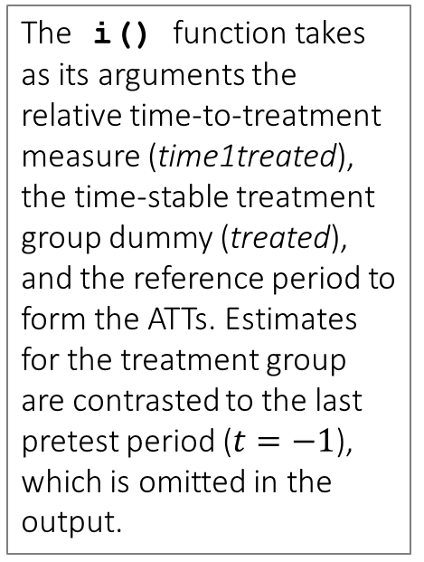
Conviction Data: Event Study Estimation
twfe.event <- feols(work ~ i(time1treated, treated, -1) | id + t, cluster = ~ id, data = nlsy.long)
print(tidy(twfe.event), n = Inf)
## [only partial output is shown]
## 10 time1treated::-5:treat… 4.98e-4 0.0168 0.0295 9.76e- 1
## 11 time1treated::-4:treat… -5.90e-3 0.0155 -0.380 7.04e- 1
## 12 time1treated::-3:treat… 1.92e-3 0.0141 0.136 8.92e- 1
## 13 time1treated::-2:treat… 4.58e-3 0.0120 0.382 7.03e- 1
## 14 time1treated::0:treated -3.70e-2 0.0110 -3.37 7.59e- 4
## 15 time1treated::1:treated -5.17e-2 0.0125 -4.14 3.53e- 5
## 16 time1treated::2:treated -5.35e-2 0.0130 -4.11 3.96e- 5
## 17 time1treated::3:treated -6.09e-2 0.0131 -4.64 3.58e- 6
## 18 time1treated::4:treated -7.18e-2 0.0136 -5.27 1.43e- 7
## 19 time1treated::5:treated -7.49e-2 0.0138 -5.42 6.25e- 8
The i() function takes as its arguments the relative time-to-treatment measure (time1treated), the time-stable treatment group dummy (treated), and the reference period to form the ATTs. Estimates for the treatment group are contrasted to the last pretest period ($t=−1$), which is omitted in the output.

Slide 19
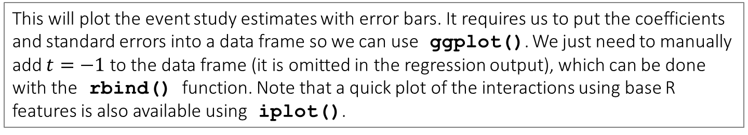
Conviction Data: Plot of Event Study Estimates
twfe.event.plot <- data.frame(relt = c(-14:-2, 0:13), b = twfe.event$coefficients, se = twfe.event$se)
twfe.event.plot <- rbind(twfe.event.plot, c(-1, 0, 0))
ggplot(twfe.event.plot, aes(x = relt, y = b)) + geom_vline(xintercept = 0, linetype = "dashed") + geom_hline(yintercept = 0, linetype = "dashed") + geom_pointrange(aes(ymin = b - 2 * se, ymax = b + 2 * se), linewidth = 0.7) + theme_gray(base_size = 15) + theme(legend.position = c(0.85, 0.8)) + labs(x = "Time to First Conviction", y = "Average Treatment Effect on the Treated", title = "Event Study Estimates of the Impact of Conviction on Employment")
This will plot the event study estimates with error bars. It requires us to put the coefficients and standard errors into a data frame so we can use ggplot(). We just need to manually add $t=−1$ to the data frame (it is omitted in the regression output), which can be done with the rbind() function. Note that a quick plot of the interactions using base R features is also available using iplot().

Slide 20
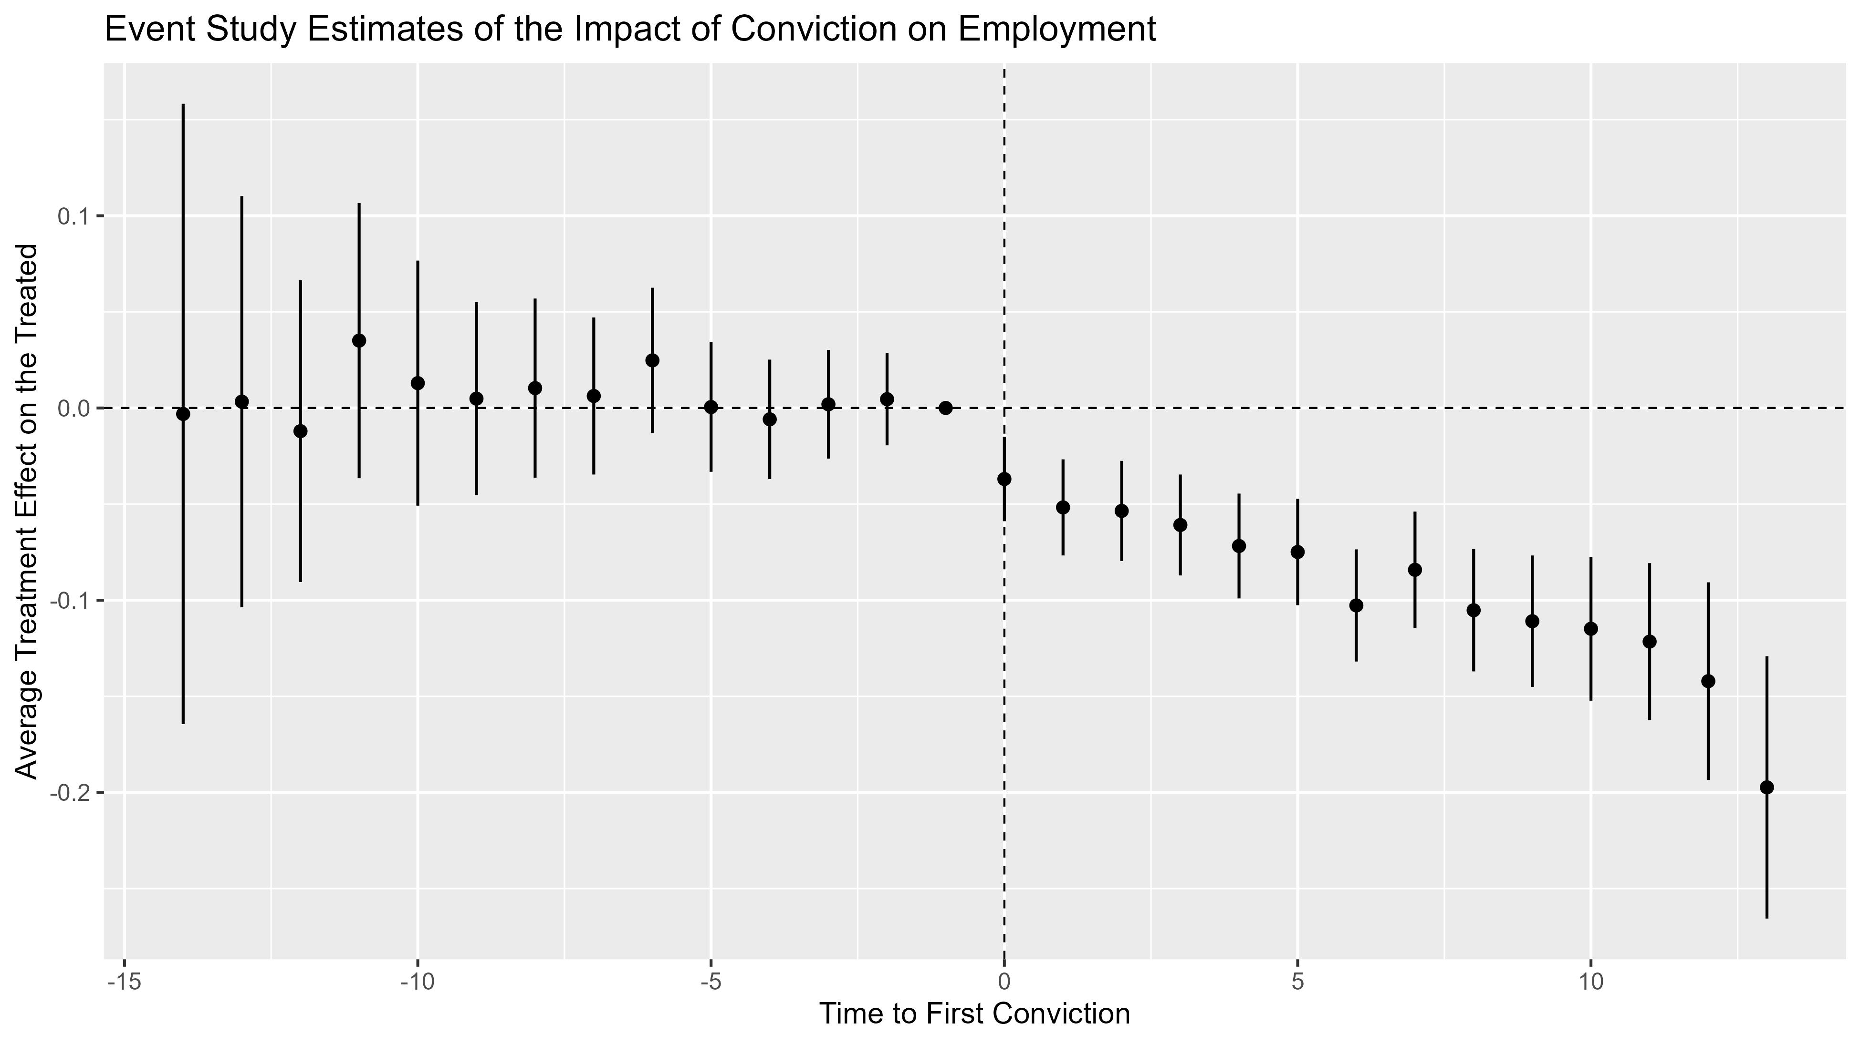
What we hope to see is confidence bands that include 0 prior to conviction, which is what we in fact see here. There is no clear evidence of non-parallel trends. And there is a clear impact of conviction on work that seems to get larger in the length of exposure.

Slide 21
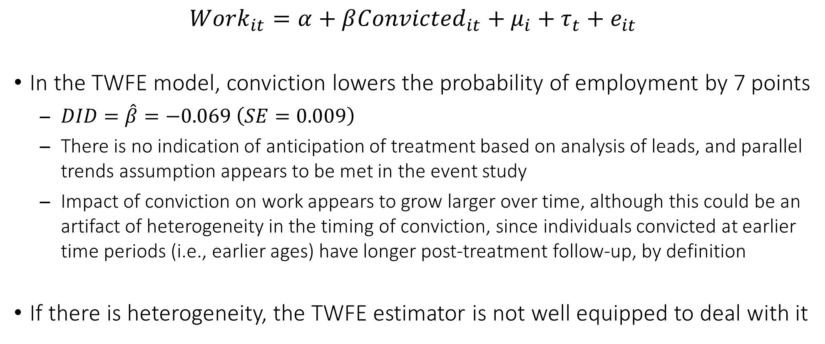
Summary Findings about the Impact of Conviction
$${Work}_{it}=α+β{Convicted}_{it}+μ_{i}+τ_{t}+e_{it}$$
In the TWFE model, conviction lowers the probability of employment by 7 points
$DID=\hat{β}=−0.069 \left(SE=0.009\right)$
There is no indication of anticipation of treatment based on analysis of leads, and parallel trends assumption appears to be met in the event study
Impact of conviction on work appears to grow larger over time, although this could be an artifact of heterogeneity in the timing of conviction, since individuals convicted at earlier time periods (i.e., earlier ages) have longer post-treatment follow-up, by definition
If there is heterogeneity, the TWFE estimator is not well equipped to deal with it

Slide 22
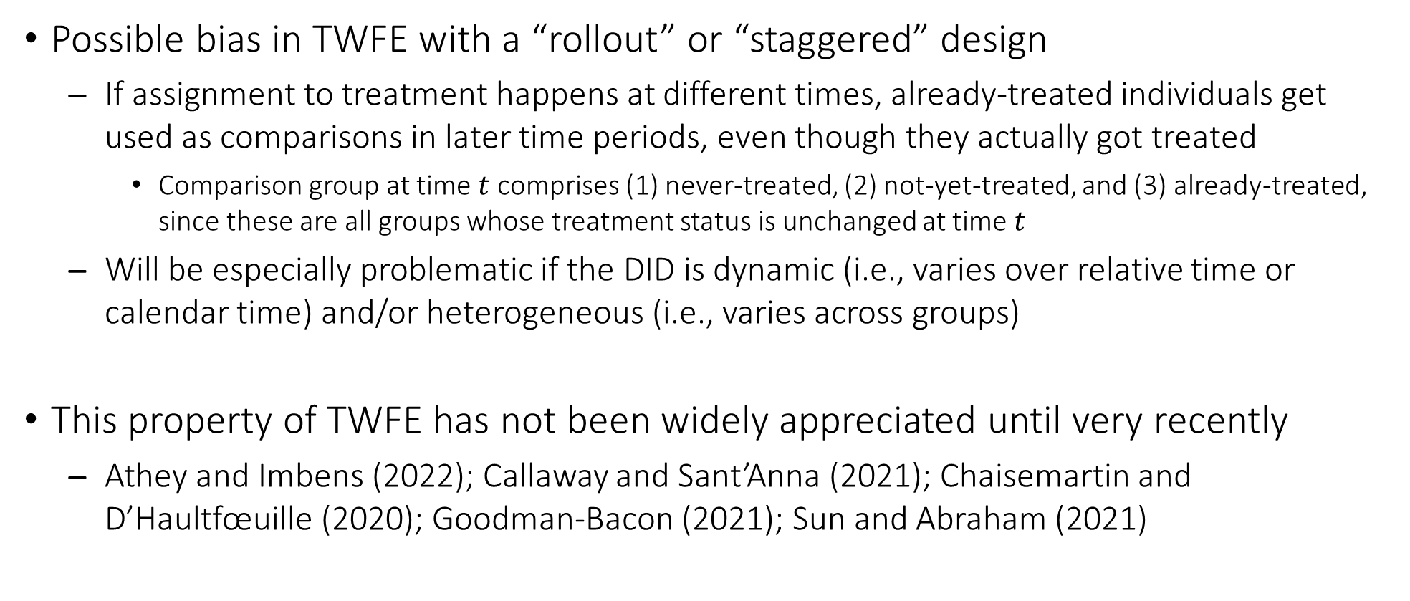
Staggered Differences in Differences
Possible bias in TWFE with a “rollout” or “staggered” design
If assignment to treatment happens at different times, already-treated individuals get used as comparisons in later time periods, even though they actually got treated
Comparison group at time $t$ comprises (1) never-treated, (2) not-yet-treated, and (3) already-treated, since these are all groups whose treatment status is unchanged at time $t$
Will be especially problematic if the DID is dynamic (i.e., varies over relative time or calendar time) and/or heterogeneous (i.e., varies across groups)
This property of TWFE has not been widely appreciated until very recently
Athey and Imbens (2022); Callaway and Sant’Anna (2021); Chaisemartin and D’Haultfœuille (2020); Goodman-Bacon (2021); Sun and Abraham (2021)

Slide 23
Group-Time Estimator for the Differences in Differences
Interaction-weighted estimator for the ATT where treatment cohort dummies are fully interacted with time period dummies (Callaway and Sant’Anna, 2021)
Cohort indicates the time period when treatment assignment happens for treated units
Can choose either never-treated subjects or not-yet-treated subjects as comparisons
Can incorporate (pretest) covariates into the model, under an assumption of conditional parallel trends among groups that share the same values of the covariates
With so many coefficients formed by the interaction, it is necessary to aggregate estimates to generate an overall ATT, or else ATTs that vary by relative time, treatment cohort, or calendar time

Slide 24
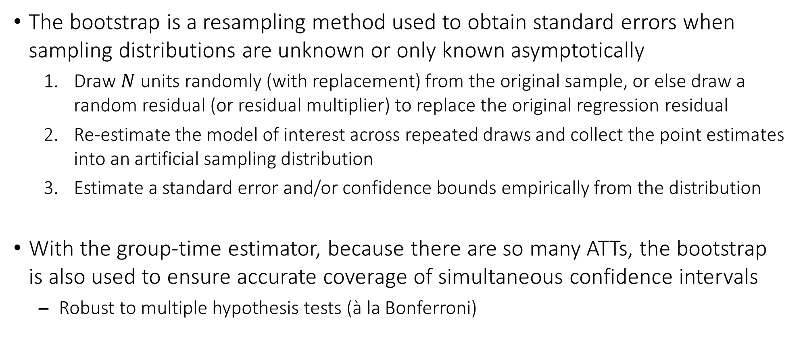
Group-Time Estimator with Bootstrap Inference
The bootstrap is a resampling method used to obtain standard errors when sampling distributions are unknown or only known asymptotically
Draw $N$ units randomly (with replacement) from the original sample, or else draw a random residual (or residual multiplier) to replace the original regression residual
Re-estimate the model of interest across repeated draws and collect the point estimates into an artificial sampling distribution
Estimate a standard error and/or confidence bounds empirically from the distribution
With the group-time estimator, because there are so many ATTs, the bootstrap is also used to ensure accurate coverage of simultaneous confidence intervals
Robust to multiple hypothesis tests (à la Bonferroni)

Slide 25
Using R for the Group-Time Estimator
att_gt(yname = yvar, idname = idvar, tname = time, gname = cohort, control_group = "group", anticipation = #, allow_unbalanced_panel = T/F, data = df)
idvar and time are the same variables we used in feols()
cohort is the treatment assignment period for treated units (0 for control units)
group selects the control units for estimation of the ATTs
"nevertreated" ⇒ Only units that never get treated during the study period (i.e., pure controls)
"notyettreated" ⇒ All units that have not yet been treated as of a given time period, which includes the never-treated units as well as the treated units at pretest time periods
Available in the did package (https://bcallaway11.github.io/did/index.html)

Slide 26
Using R for the Group-Time Estimator
With the group-time estimator, because there is no single ATT, we can choose from a number of post-estimation aggregation methods
aggte(obj, agg = "simple") ⇒ Report overall ATT
aggte(obj, agg = "dynamic") ⇒ Report ATTs by relative time period
aggte(obj, agg = "group") ⇒ Report ATTs by treatment cohort
aggte(obj, agg = "calendar") ⇒ Report ATTs by calendar time period
Default options carried over from att_gt() include standard errors estimated via the cluster bootstrap (bstrap = T, biters = 1000), and uniform confidence bands (cband = T) which cover all group-time ATTs with fixed probability
ggdid() provides a quick plot of the aggregated ATTs in ggplot2 style

Slide 27
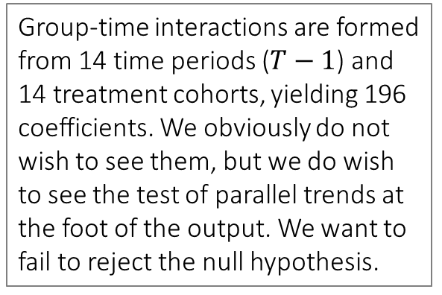
Conviction Data: Callaway and Sant’Anna Method
nlsy.long <- nlsy.long %>% mutate(wave1treated = replace_na(wave1convic, 0))
set.seed(20231114)
csdid <- att_gt(yname = "work", idname = "id", tname = "t", gname = "wave1treated", control_group = "nevertreated", allow_unbalanced_panel = T, data = nlsy.long)
csdid
## [all intermediate output is omitted]
## P-value for pre-test of parallel trends assumption: 0.09512
## Control Group: Never Treated, Anticipation Periods: 0
## Estimation Method: Doubly Robust
The original cohort variable (wave1convic) is missing for untreated units, so we create a new cohort variable where they are set to 0 (wave1treated).
Group-time interactions are formed from 14 time periods ($T−1$) and 14 treatment cohorts, yielding 196 coefficients. We obviously do not wish to see them, but we do wish to see the test of parallel trends at the foot of the output. We want to fail to reject the null hypothesis.

Slide 28
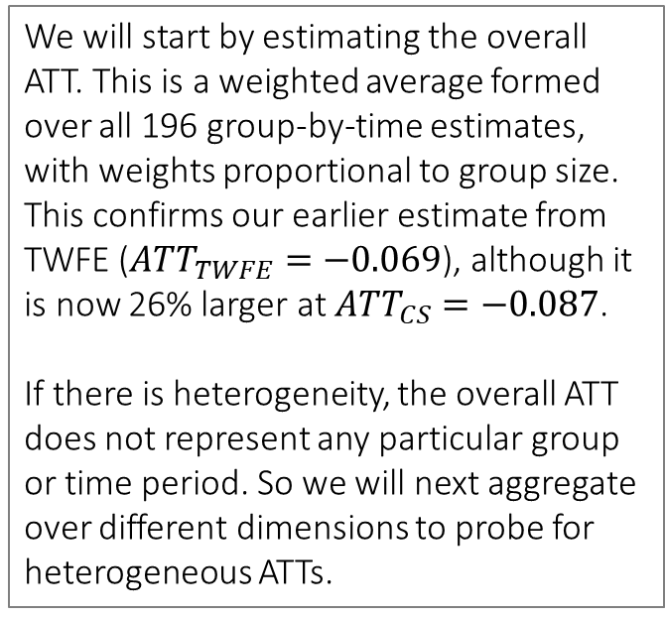
Conviction Data: Estimate the Overall ATT
csdid.avg <- aggte(csdid, "simple")
summary(csdid.avg)
## [some intermediate output is not shown]
## ATT Std. Error [ 95% Conf. Int.]
## -0.0869 0.012 -0.1105 -0.0634 *
## ---
## Signif. codes: `*' confidence band does not cover 0
##
## Control Group: Never Treated, Anticipation Periods: 0
## Estimation Method: Doubly Robust
We will start by estimating the overall ATT. This is a weighted average formed over all 196 group-by-time estimates, with weights proportional to group size. This confirms our earlier estimate from TWFE (${ATT}_{TWFE}=−0.069$), although it is now 26% larger at ${ATT}_{CS}=−0.087$.
If there is heterogeneity, the overall ATT does not represent any particular group or time period. So we will next aggregate over different dimensions to probe for heterogeneous ATTs.

Slide 29
Conviction Data: Heterogeneity by Relative Time
csdid.dyn <- aggte(csdid, "dynamic")
csdid.dyn.out <- data.frame(rel.t = csdid.dyn$egt, att = csdid.dyn$att.egt, se = csdid.dyn$se.egt)
ggplot(csdid.dyn.out, aes(x = rel.t, y = att)) + geom_vline(xintercept = 0, linetype = "dashed") + geom_hline(yintercept = 0, linetype = "dashed") + geom_pointrange(aes(ymin = att - 2 * se, ymax = att + 2 * se), linewidth = 0.7) + theme_gray(base_size = 15) + theme(legend.position = c(0.85, 0.8)) + labs(x = "Time to First Conviction", y = "Average Treatment Effect on the Treated", title = "Dynamic Impact of Conviction on Employment")
The type = "dynamic" option produces the group-time equivalent to event study estimates. Let’s pull the coefficients and standard errors into a data frame and use ggplot(). Alternatively, for a quick plot, we could just use the canned ggdid() without having to create a data frame.

Slide 30
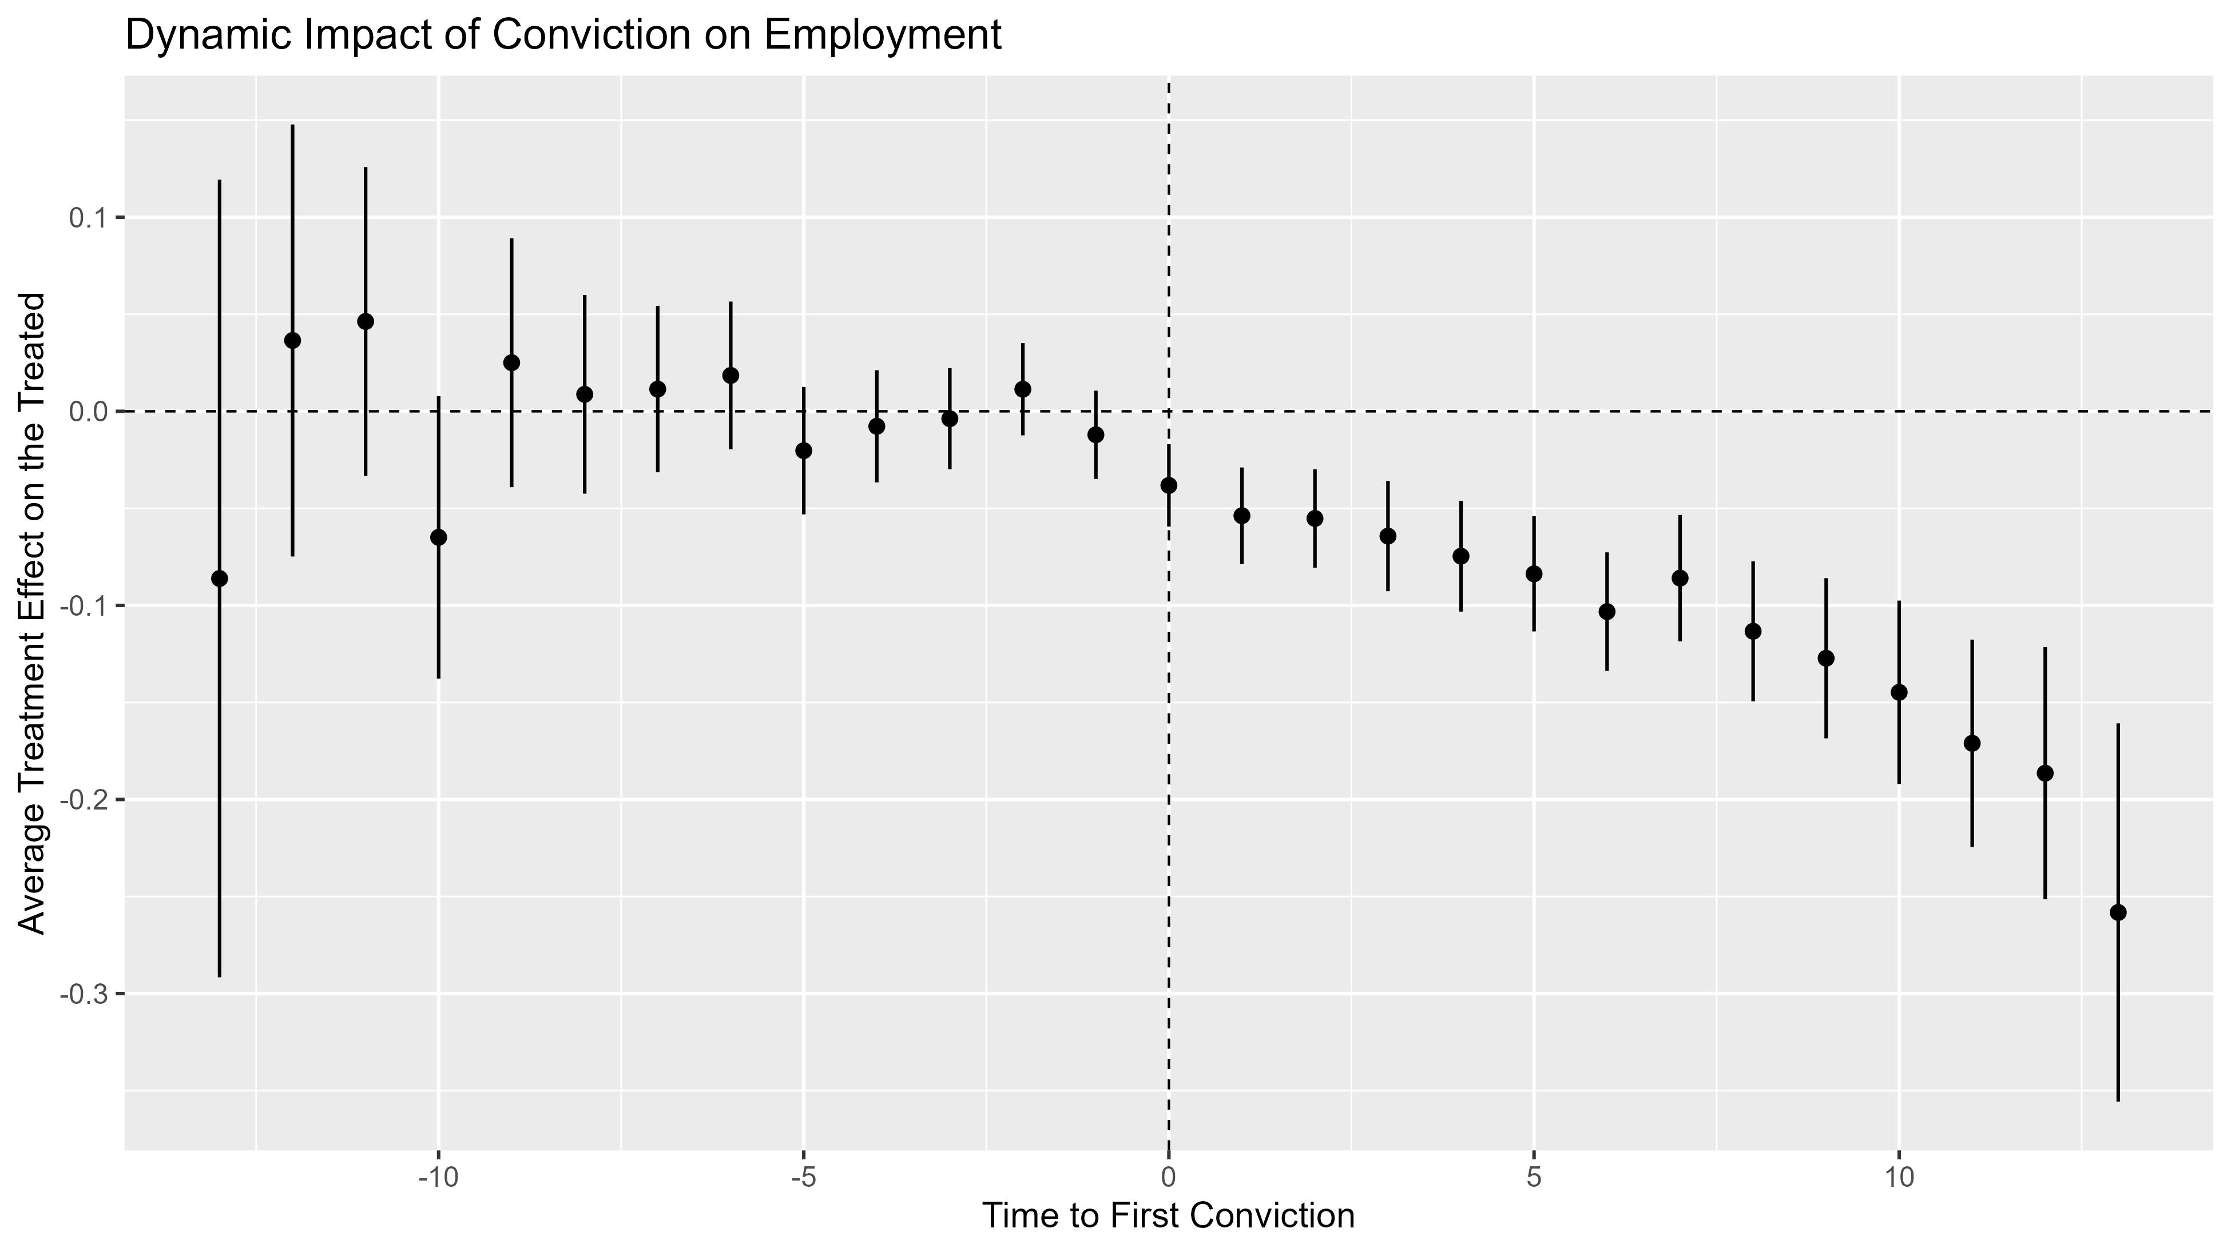
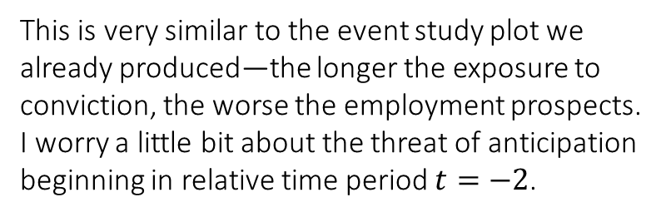
This is very similar to the event study plot we already produced—the longer the exposure to conviction, the worse the employment prospects. I worry a little bit about the threat of anticipation beginning in relative time period $t=−2$.

Slide 31
Conviction Data: Heterogeneity by Treatment Cohort
csdid.coh <- aggte(csdid, "group")
csdid.coh.out <- data.frame(t = csdid.coh$egt, att = csdid.coh$att.egt, se = csdid.coh$se.egt)
ggplot(csdid.coh.out, aes(x = t, y = att)) + geom_hline(yintercept = 0, linetype = "dashed") + geom_pointrange(aes(ymin = att - 2 * se, ymax = att + 2 * se), linewidth = 0.7) + theme_gray(base_size = 15) + theme(legend.position = c(0.85, 0.8)) + labs(x = "Interview Round of First Conviction", y = "Average Treatment Effect on the Treated", title = "Cohort-Specific Impact of Conviction on Employment")
The type = "group" option produces the cohort-specific ATTs. The cohorts are treated units who experience their first conviction at a different interview round. As before, let’s pull the coefficients and standard errors into a data frame and plot them with ggplot().

Slide 32
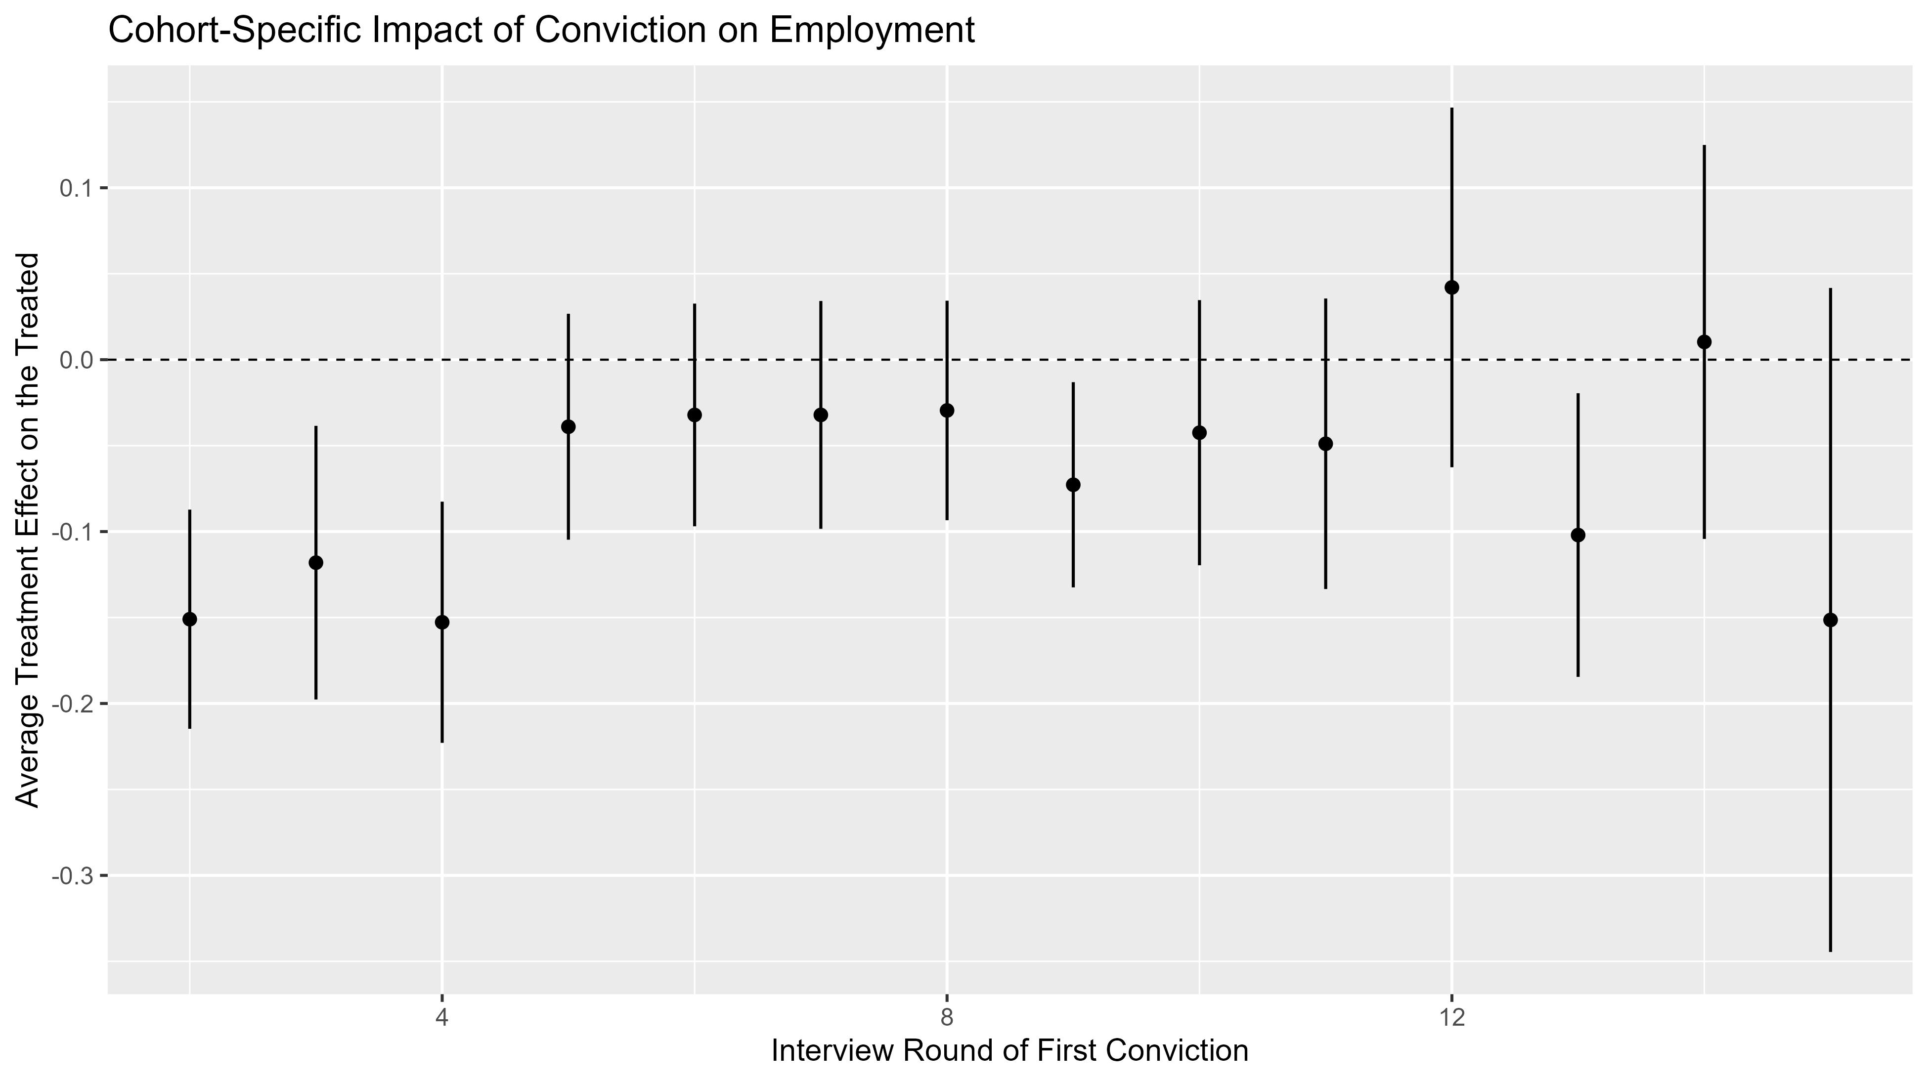
Each estimate represents a different treatment cohort, which averages over all posttest time periods for that cohort. Notice that individuals convicted at early rounds tend to have a larger ATT. Because these individuals are younger, by definition, this implies heterogeneity by age of first exposure to conviction.

Slide 33
Conviction Data: Heterogeneity by Calendar Time
csdid.cal <- aggte(csdid, "calendar")
csdid.cal.out <- data.frame(t = csdid.cal$egt, att = csdid.cal$att.egt, se = csdid.cal$se.egt)
ggplot(csdid.cal.out, aes(x = t, y = att)) + geom_hline(yintercept = 0, linetype = "dashed") + geom_pointrange(aes(ymin = att - 2 * se, ymax = att + 2 * se), linewidth = 0.7) + theme_gray(base_size = 15) + theme(legend.position = c(0.85, 0.8)) + labs(x = "Interview Round", y = "Average Treatment Effect on the Treated", title = "Calendar-Specific Impact of Conviction on Employment")
The type = "calendar" option produces the calendar-time-specific ATTs. The estimates apply to all individuals who have been treated as of a particular interview round. Again, let’s pull the coefficients and standard errors into a data frame and use ggplot().

Slide 34
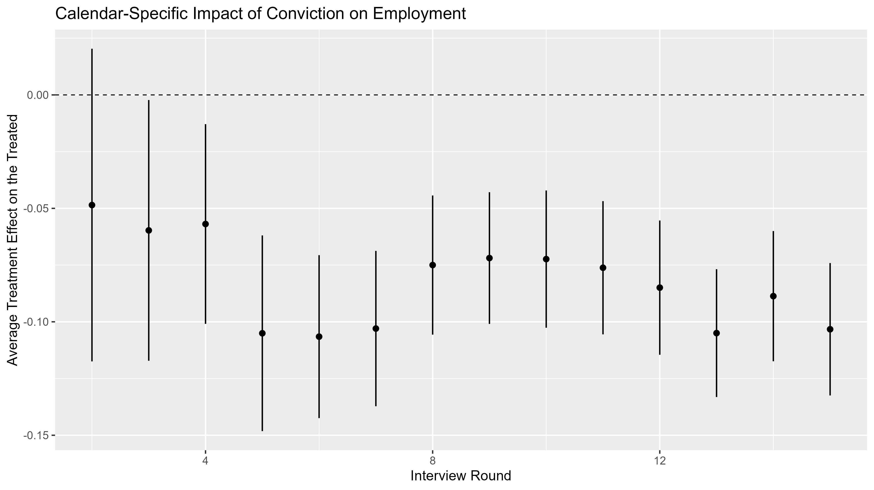
These estimates all vary within roughly 6 probability points. The slightly larger impact in periods 5-7 (roughly 2001-2003) might be an aftermath of the 2001 recession, or even September 11th.

Slide 35
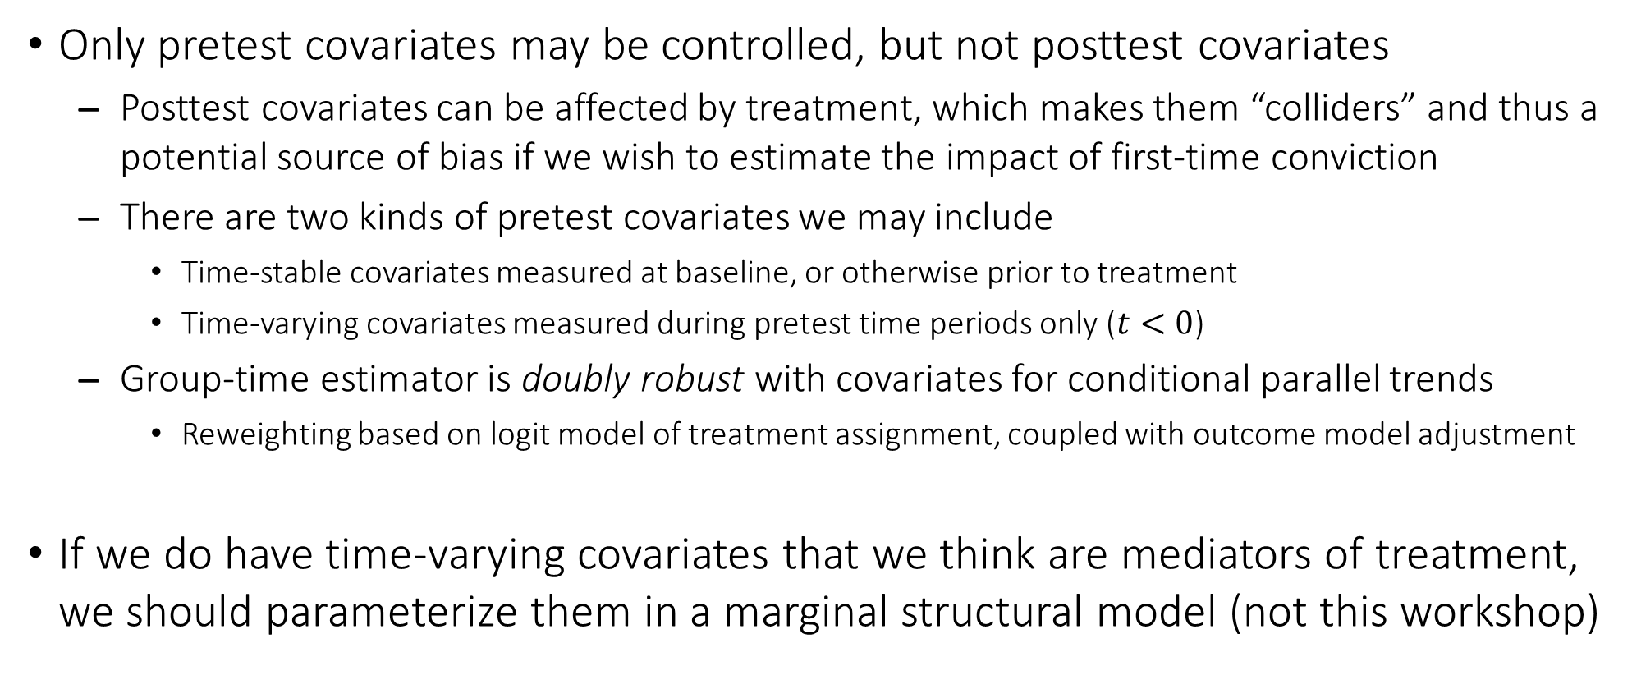
Including Covariates in the Group-Time Model
Only pretest covariates may be controlled, but not posttest covariates
Posttest covariates can be affected by treatment, which makes them “colliders” and thus a potential source of bias if we wish to estimate the impact of first-time conviction
There are two kinds of pretest covariates we may include
Time-stable covariates measured at baseline, or otherwise prior to treatment
Time-varying covariates measured during pretest time periods only ($t<0$)
Group-time estimator is doubly robust with covariates for conditional parallel trends
Reweighting based on logit model of treatment assignment, coupled with outcome model adjustment
If we do have time-varying covariates that we think are mediators of treatment, we should parameterize them in a marginal structural model (not this workshop)

Slide 36
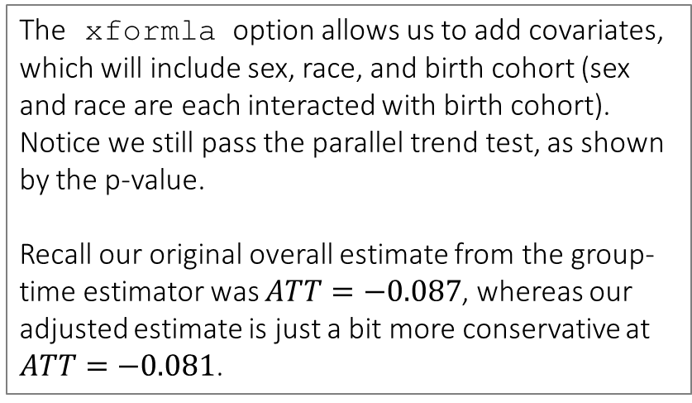
Conviction Data: Covariate-Adjusted ATT
set.seed(20231114)
csdid.cov <- att_gt(yname = "work", idname = "id", tname = "t", gname = "wave1treated", control_group = "nevertreated", allow_unbalanced_panel = T, xformla = ~ (male + minrty) * cohort, data = nlsy.long)
csdid.cov$Wpval
## [,1]
## [1,] 0.10317
csdid.cov.avg <- aggte(csdid.cov, type = "simple")
csdid.cov.avg
## [some intermediate output is not shown]
## ATT Std. Error [ 95% Conf. Int.]
## -0.0806 0.0107 -0.1016 -0.0595 *
The xformla option allows us to add covariates, which will include sex, race, and birth cohort (sex and race are each interacted with birth cohort). Notice we still pass the parallel trend test, as shown by the p-value.
Recall our original overall estimate from the group-time estimator was $ATT=−0.087$, whereas our adjusted estimate is just a bit more conservative at $ATT=−0.081$.

Slide 37
Conviction Data: Anticipation-Adjusted ATT
set.seed(20231114)
csdid.ant <- att_gt(yname = "work", idname = "id", tname = "t", gname = "wave1treated", control_group = "nevertreated", allow_unbalanced_panel = T, anticipation = 2, data = nlsy.long)
csdid.ant.avg <- aggte(csdid.ant, type = "simple")
csdid.ant.avg
## [some intermediate output is not shown]
## ATT Std. Error [ 95% Conf. Int.]
## -0.06 0.0157 -0.0907 -0.0293 *
We noticed earlier that there might be some mild anticipation—recall the group-time dynamic ATTs. We can build this into the model by changing the pretest reference period, which uses a “long difference” to form the difference in differences. The anticipation option allows us to choose the number of time periods where treated units can “anticipate” their future treatment status.

Slide 38
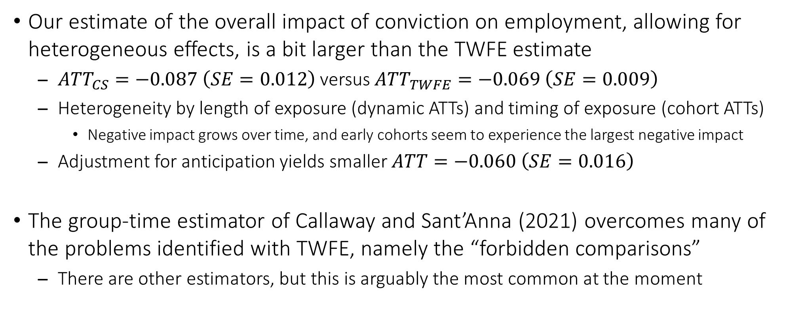
Summary of Heterogeneous Difference in Differences
Our estimate of the overall impact of conviction on employment, allowing for heterogeneous effects, is a bit larger than the TWFE estimate
${ATT}_{CS}=−0.087 \left(SE=0.012\right)$ versus ${ATT}_{TWFE}=−0.069 \left(SE=0.009\right)$
Heterogeneity by length of exposure (dynamic ATTs) and timing of exposure (cohort ATTs)
Negative impact grows over time, and early cohorts seem to experience the largest negative impact
Adjustment for anticipation yields smaller $ATT=−0.060 \left(SE=0.016\right)$
The group-time estimator of Callaway and Sant’Anna (2021) overcomes many of the problems identified with TWFE, namely the “forbidden comparisons”
There are other estimators, but this is arguably the most common at the moment

Slide 39
General Comments on Difference in Differences
Estimation of DID from TWFE gets complicated with staggered treatment entry
Inappropriate comparisons ⇒ Subjects that have already been treated get used as comparison units, despite having been treated
Heterogeneity in ATTs ⇒ If the ATT varies over (relative) time or across treatment cohorts, there is no longer any single ATT, so a more robust method is required
Anticipatory effects and non-parallel trends ⇒ These are not unique to staggered DID, but pre-screening bias and statistical power are key concerns with tests of “pretrends”
We just scratched the surface, but good guides to estimators (and software) are in Roth et al. (2023) and de Chaisemartin and D’Haultfœuille (2023)

Slide 40
References
Athey, Susan, and Guido W. Imbens. 2022. Design-based analysis in difference-in-differences settings with staggered adoption. Journal of Econometrics 226: 62–79.
Callaway, Brantly, and Pedro H. C. Sant’Anna. 2021. Difference-in-differences with multiple time periods. Journal of Econometrics 225: 200–230.
de Chaisemartin, Clément, and Xavier D’Haultfœuille. 2020. Two-way fixed effects estimators with heterogeneous treatment effects. American Economic Review 110: 2964–2996.
de Chaisemartin, Clément, and Xavier D’Haultfœuille. 2023. Two-way fixed effects and differences-in-differences with heterogeneous treatment effects: A survey. Econometrics Journal, in press.
Goodman-Bacon, Andrew. 2021. Difference-in-differences with variation in treatment timing. Journal of Econometrics 225: 254–277.
Roth, Jonathan, Pedro H. C. Sant’Anna, Alyssa Bilinski, and John Poe. 2023. What’s trending in difference-in-differences? A synthesis of the recent econometrics literature. Journal of Econometrics 235: 2218–2244.
Sun, Liyang, and Sarah Abraham. 2021. Estimating dynamic treatment effects in event studies with heterogeneous treatment effects. Journal of Econometrics 225: 175–199.

